Slide 1
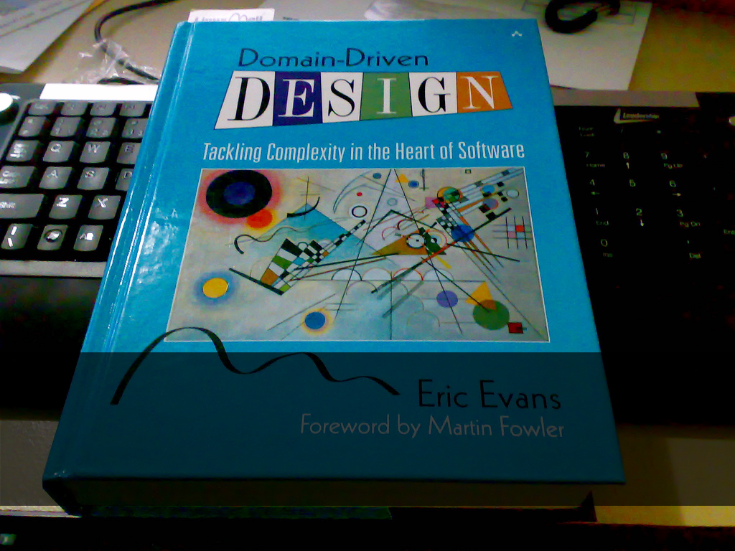
Domain Driven Design 101
Notes:
Hi guys, my name is
I'm a .NET developer at Provoke solutions
Gonna talk to you today about an introductory session to domain driven design

Slide 2
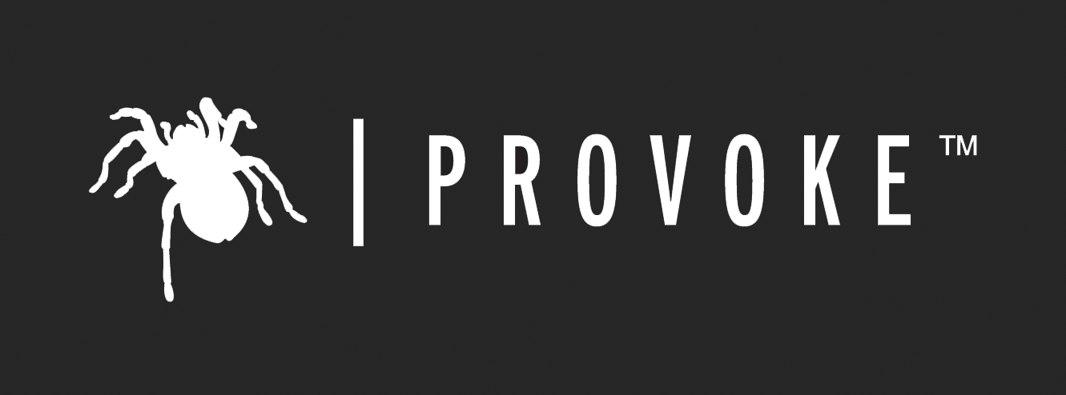

Slide 3
Agenda
Why
Building blocks
Repositories, entities, specifications etc
Putting it to practice
Dependency injection
Persistence
Validation
Architecture
Challenges
When not to use DDD
Resources

Slide 4

Software is complicated
Notes:
-I thought I'd start with a story
-Three years ago, project went really badly
-Classic 3-tier ASP.NET, datasets, stored procedures, business layer, code behind
-Performance reviews
-20 page form, save drafts, workflow and notifications
-Handed to me for phase 2 upgrades
-We struggled to hit pretty generous deadlines
-Introduce one new feature, break three-four others
-Pretty serious maintainability problems were making us look bad
-Nothing malicious, we had coding standards and conventions
-But business logic always ended up scattered
-Behaviour separated from data
-Impossible to unit test
-Change stuff at 3 layers
-Unhappy time for everyone involved

Slide 5
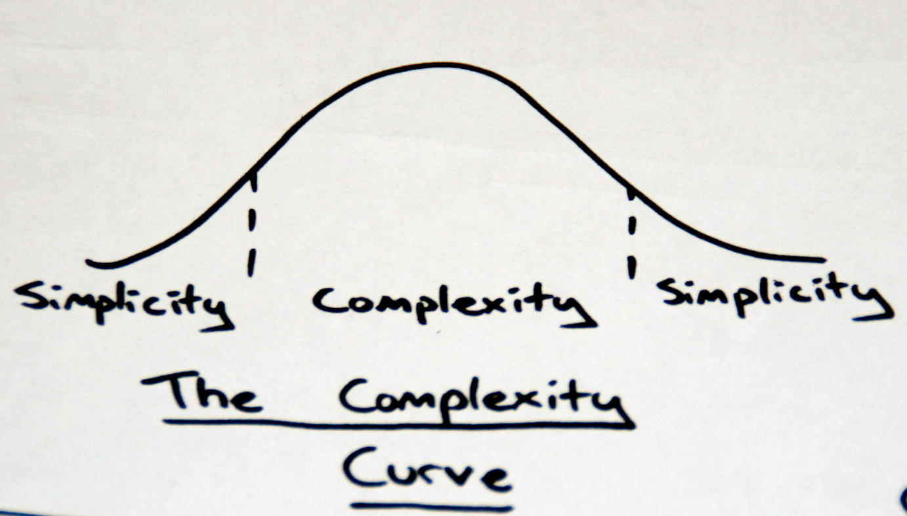
We solve complexity in software by distilling our problems
Notes:
-Complexity =enemy
-Creeps in
-Affects ability to deliver
-Separate concerns
-Breaking into smaller units
-DDD is about distilling into an explicit model
-All in one place
-Easier to work with than sprocs/code behind

Slide 6
public bool CanBook(Cargo cargo, Voyage voyage)
{
double maxBooking = voyage.Capacity * 1.1;
if (voyage.BookedCargoSize + cargo.Size > maxBooking)
return false;
...
}
public bool CanBook(Cargo cargo, Voyage voyage)
{
if (!overbookingPolicy.IsAllowed(cargo, voyage))
return false;
...
}
DDD is about making concepts explicit
Notes:
-Not complicated
-Important business concept hidden
-Not just anonymous calculation
-Overbooking policy
-2nd example doesn’t need comments
-DDD is about making concepts explicit
-As separate objects

Slide 7
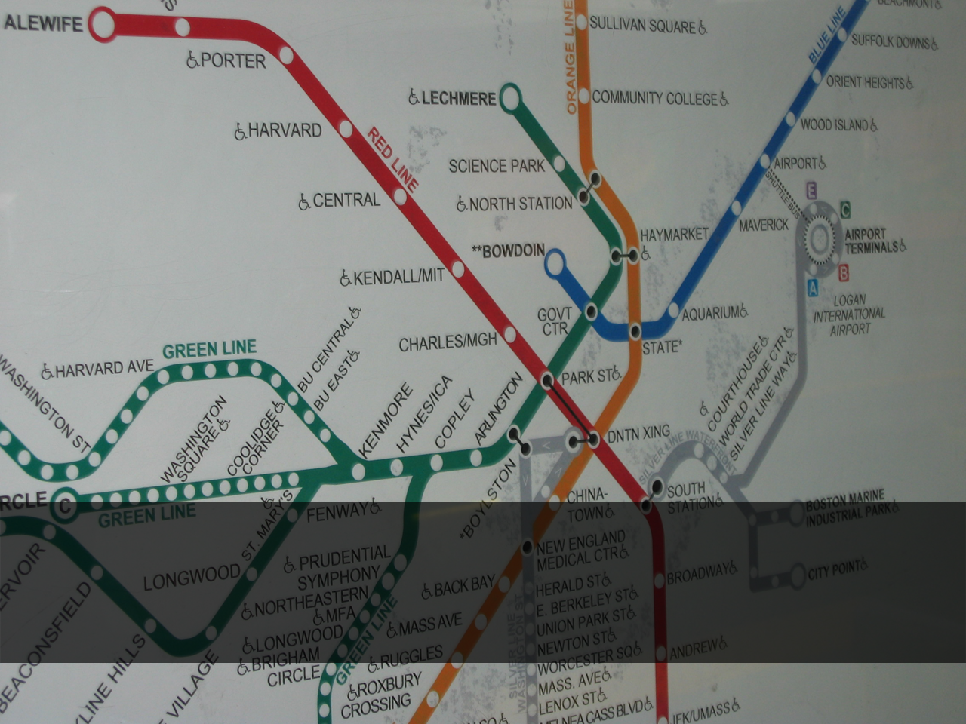
Domain Model
Notes:
-Imagine if you could truly isolate all your business logic
-DDD is about creating a model of the domain
-Subject area
-Not usually related to computers
-Usually based on people and business
-Abstraction of reality
-Important bits
-e.g.
-Domain model includes data AND behaviour
-Isolated layer in your application
-Living breathing C#, not UML
-Completely free from the tech used to implement it
-No database, no XML, no files, no web services, biztalk, sharepoint
-No transactions
-Just pure domain concepts
-No dependencies on anything except itself

Slide 8

Ubiquitous language
Notes:
-Expressed in
-Quite often there is a language wall between clients and developers
-They says discontinue a product, you translate it to delete it from the product table

Slide 9
public interface ISapService
{
double GetHourlyRate(int sapId);
}
û
A poor abstraction
public interface IPayrollService
{
double GetHourlyRate(Employee employee);
}
ü
Intention-revealing interfaces
Notes:
-Say we have an app that has to get an employee’s hourly rate
-First example is all about the implementation details
-Happens to be stored in SAP at the moment
-SAP identifier is an implementation detail
-Intention revealing interfaces
-Expressed in the ubquitious language

Slide 10
public class Employee
{
void ApplyForLeave(DateTime start,
DateTime end,
ILeaveService leaves)
{
...
}
}
Notes:
-Doesn’t just apply to nouns, but verbs as well
-”An employee applies for leave”
-Leaves don’t come outta thin air
-So we put a method on employee
-Makes roles clear, who does what
-Also applies to bidirectional associations

Slide 11

Domain Expert
Notes:
-Someone you talk to when you’re figuring all this stuff out
-If you’re doing agile he might join team
-Not necessarily technical
-I have a picture of a business owner
-Can explain not only how, but WHY
-BAs not best, just proxy

Slide 12

Entities
Notes:
-Object with a thread of continuity
-Lasts the lifetime of an object
-Like a person
-You can change everything about them: name, address, sex
-But over their whole lifetime they’re still the same person
-Same with object, entities are the same object for the duration of their lifetime
-Implemented with an identifier or ID

Slide 13

Value Types
Notes:
-Value types on the other hand
-Are identified by their value
-E.g. color, addresses, shopping lists

Slide 14
public class Employee : IEquatable<Employee>
{
public bool Equals(Employee other)
{
return this.Id.Equals(other.Id);
}
}
Entities are the same if they have the same identity
public class PostalAddress : IEquatable<PostalAddress>
{
public bool Equals(PostalAddress other)
{
return this.Number.Equals(other.Number)
&& this.Street.Equals(other.Street)
&& this.PostCode.Equals(other.PostCode)
&& this.Country.Equals(other.Country);
}
}
Value Types are the same if they have the same value

Slide 15
public class Colour
{
public int Red { get; private set; }
public int Green { get; private set; }
public int Blue { get; private set; }
public Colour(int red, int green, int blue)
{
this.Red = red;
this.Green = green;
this.Blue = blue;
}
public Colour MixInTo(Colour other)
{
return new Colour(
Math.Avg(this.Red, other.Red),
Math.Avg(this.Green, other.Green),
Math.Avg(this.Blue, other.Blue));
}
}
Value Types are immutable

Slide 16
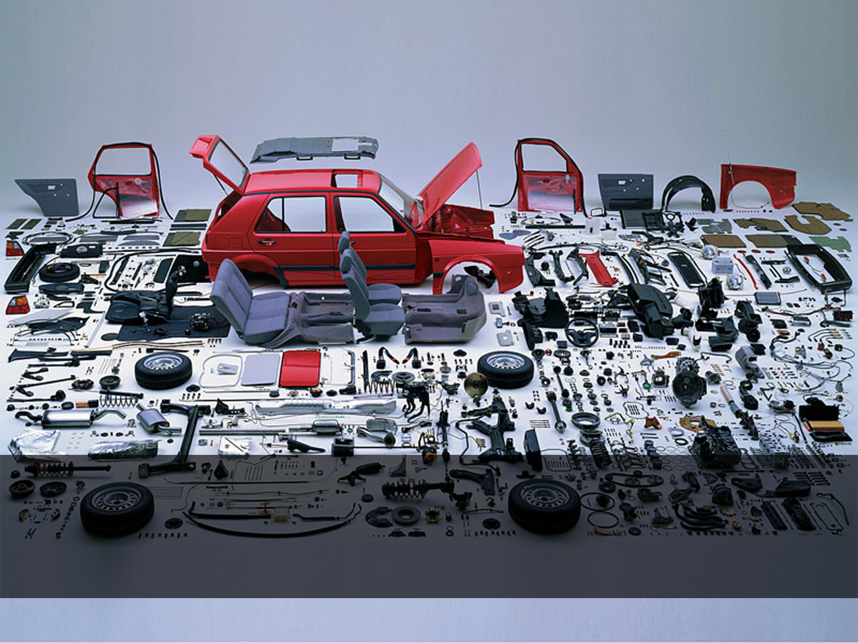
Aggregates
Notes:
-Cluster of objects
-Consistency boundary
-Simplifies things massively
-Master object called aggregate root

Slide 17
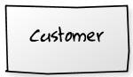
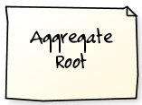
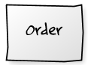
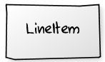
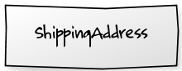
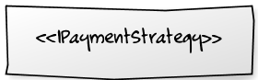
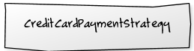
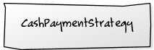
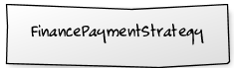
*
Aggregate root
Notes:
-Cannot hold reference to anything except the root
-Can’t access any entity except from the root
-Consistency boundary
-Save the whole thing
-Cascades
-Versioning
-Locking – coarse grain lock
-No longer cherry picking

Slide 18
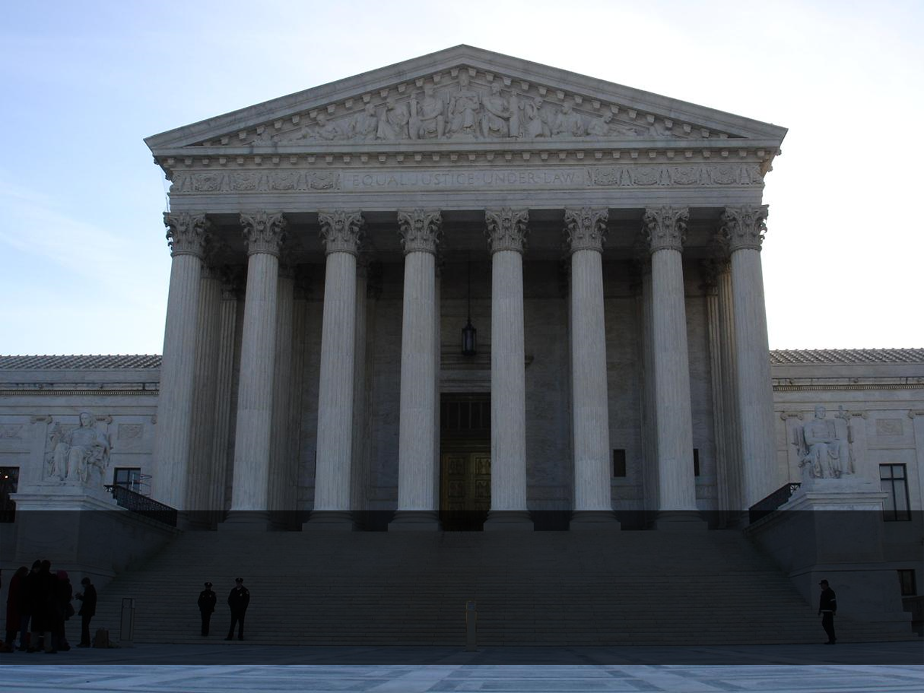
Repositories
Notes:
-Common pattern
-When you need something
-Where you put things when your application isn’t using them
Abstracts away persistence
- SQL database
- Object relational mappers
- Stored procs
- Caching
- Fetching strategies
One per aggregate root

Slide 19
public interface IEmployeeRepository
{
Employee GetById(int id);
void Add(Employee employee);
void Remove(Employee employee);
IEnumerable<Employee> GetStaffWorkingInRegion(Region region);
}
Repositories provide collection semantics and domain queries
Notes:
-Interfaces are first-class member of the domain
-Collection semantics
-No CRUD (save/update), just add/remove
-ORM dirty tracking, get out of this commit mindset
-Only domain queries, not general data access
-Search
-Reporting (OLAP vs OLTP)

Slide 20
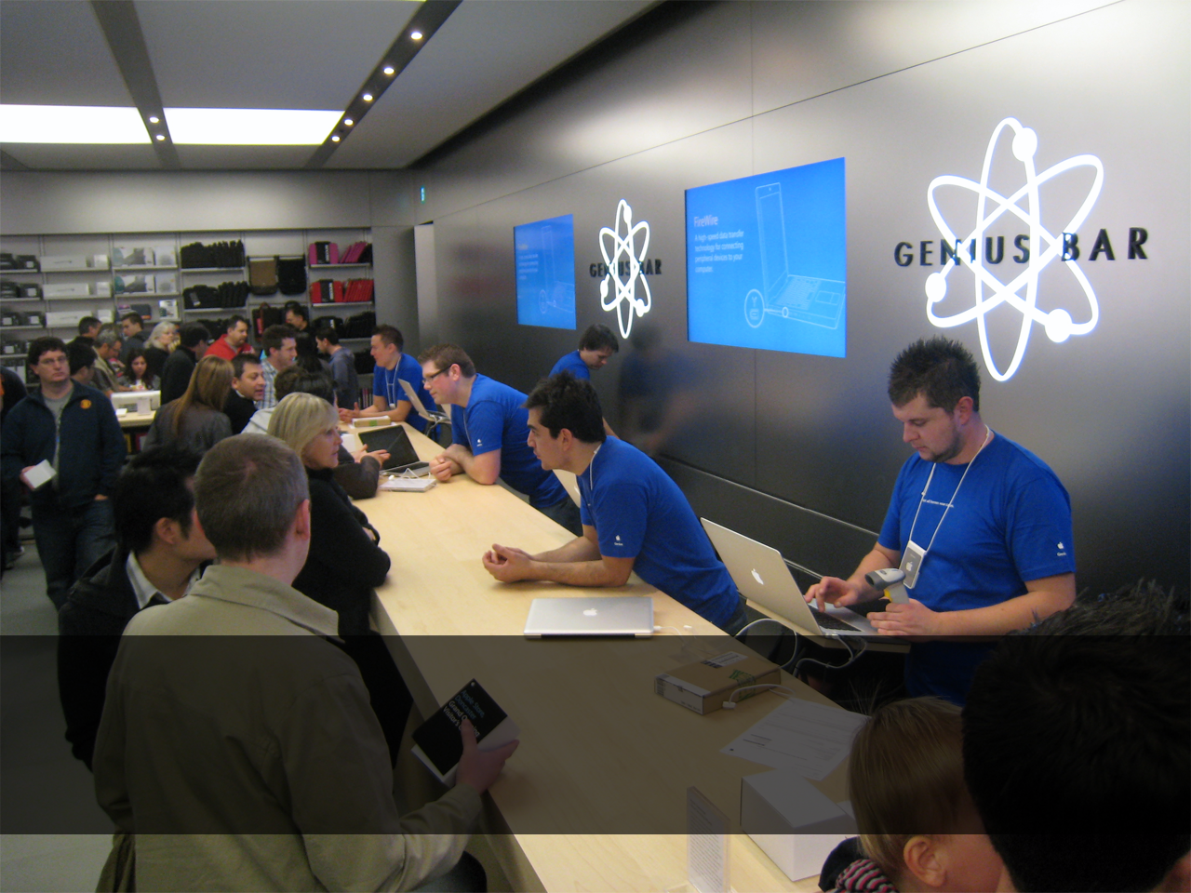
Domain Services
Notes:
-Behaviour that isn’t logically part of any entity

Slide 21
public interface ITripService
{
float GetDrivingDistanceBetween(Location a, Location b);
}
Notes:
-Trip service
-Again uses UL
-TripService, not GoogleMapsWebAPI service

Slide 22

Specifications
Notes:
-Encapsulates a single business rule
-Tests if an object satisfies the specified criteria
-Brings UL into code as an explicit NAMED concept
-Promotes DRY
-Validation
-Creating objects
-Querying

Slide 23
class GoldCustomerSpecification : ISpecification<Customer>
{
public bool IsSatisfiedBy(Customer candidate)
{
return candidate.TotalPurchases > 1000.0m;
}
}
if (new GoldCustomerSpecification().IsSatisfiedBy(employee))
// apply special discount
Specifications encapsulate a single rule

Slide 24

Specifications can be used…
to construct objects
Notes:
-When you order a pizza
-Say what toppings, crust
-If you think about it
-Not a pizza yet

Slide 25
var spec = new PizzaSpecification()
.BasedOn(new MargaritaPizzaSpecification())
.WithThickCrust()
.WithSwirl(Sauces.Bbq)
.WithExtraCheese();
var pizza = new PizzaFactory().CreatePizzaFrom(spec);
Constructing objects according to a specification

Slide 26

Specifications can be used…
for querying

Slide 27
public interface ICustomerRepository
{
IEnumerable<Customer> GetCustomersSatisfying(
ISpecification<Customer> spec);
}
var goldCustomerSpec = new GoldCustomerSpecification();
var customers = this.customerRepository
.GetCustomersSatisfying(goldCustomerSpec);
Querying for objects that match some specification

Slide 28
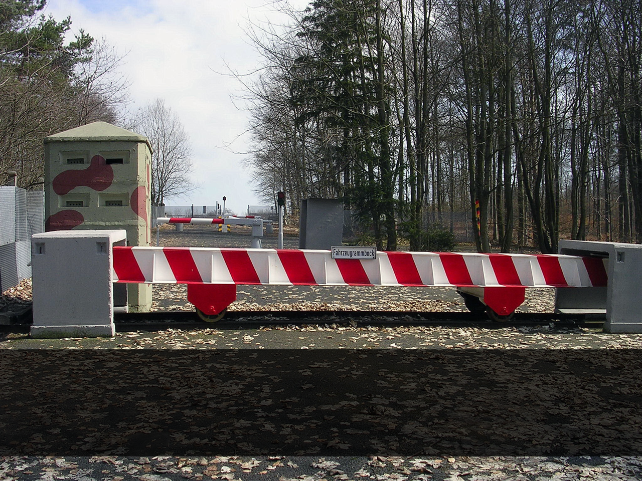
Anticorruption Layer
Notes:
-As business get more of their systems integrated
-Becoming more common for writing systems that need to talk to other systems
-But each system has it’s own semantics that we don’t want in our abstraction
-Anticorruption layer maps external objects to fit our model

Slide 29
Your subsystem
Anti-corruption layer
Other subsystem
Notes:
-Our nice domain model on the left
-Little cohesive objects
-Hairy tangled third party system
-Its own layer
-Internals
-Facade or adapter patterns

Slide 30
Any 3rd party system that I have to integrate with was written by a drunken monkey typing with his feet.
Oren Eini aka Ayende
Notes:
-Another reason why you should use an anti corruption layer
-Quote, an Assumption you should make
-Lets you mock out the external system
-Swap in an alternative when it goes down, for testing etc
-Not just for DDD

Slide 31
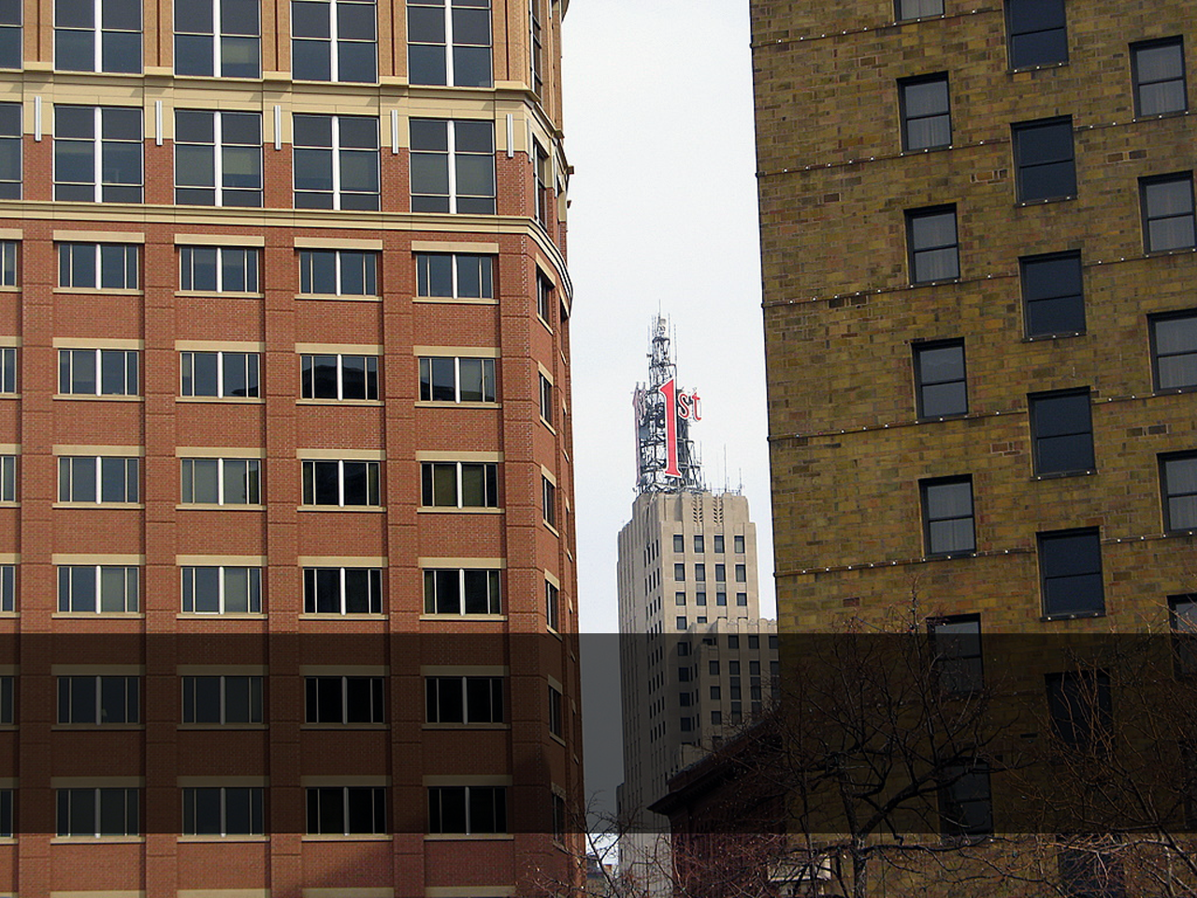
Bounded Context
Notes:
-Different definitions in different contexts
-E.g. different departments may reuse language differently
-SOA people often try to shoehorn them together into one grand unified model of the universe
-Not how the business works in real life
-DDD Embrace each context’s language and model

Slide 32
public class Lead
{
public IEnumerable<Opportunity> Opportunities { get; }
public Person Contact { get; }
}
public class Client
{
public IEnumerable<Invoice> GetOutstandingInvoices();
public Address BillingAddress { get; }
public IEnumerable<Order> PurchaseHistory { get; }
}
public class Customer
{
public IEnumerable<Ticket> Tickets { get; }
}
Notes:
-Could smush together
-Pretty big and unwieldy
-Contradictions around contact
-Sales: contact is business development manager
-Support: contact is developers
-Each is a separate domain model
-Separate ubiquitous language
-Separate persistence
-Anticorruption layers between them

Slide 33

Dependency Injection
Notes:
-”Don’t call us, we’ll call you” principle

Slide 34
public interface INotificationService
{
void Notify(Employee employee, string message);
}
An interface defines the model
public class EmailNotificationService : INotificationService
{
void Notify(Employee employee, string message)
{
var message = new MailMessage(employee.Email, message);
this.smtpClient.Send(message);
}
}
Far away, a concrete class satisfies it
Notes:
-All about interfaces
-Decouple our code
-Depend on the model, not the implementation
-Users of INotificationService have no idea

Slide 35
public class LeaveService
{
private readonly INotificationService notifications;
public LeaveService(INotificationService notifications)
{
this.notifications = notifications;
}
public void TakeLeave(Employee employee, DateTime start,
DateTime end)
{
// do stuff
this.notifications.Notify(employee, "Leave approved.");
}
}
Dependencies are injected at runtime
Notes:
-Instead of calling out
-Inversion of control

Slide 36

Persistence Ignorance
Notes:
-In stored-proc based apps changes don’t become official until ‘committed’
-The database IS the model
-Data model gets built first
-And the app is just a thin layer and some validation on top
-Require frequent round trips
-One foot in the DB at all times
-Impossible to unit test
-In DDD we recognize relational schemas has different objectives
-Performance, normalization, indexing
-Not a 1:1 mirror of the domain model
-Just an implementation detail
-A place to put things when your app isn’t using them
-Big shift in thinking
-Domain model first, figure out how to map it to a relational schema later
-But greatly simplifies things
-Opens up unit testing
-Lets you write a DB later

Slide 37
…ordinary classes where you focus on the business problem at hand without adding stuff for infrastructure-related reasons… nothing else should be in the Domain Model.
Notes:
-Ultimate goal of object relational mappers
-Persistence ignorance
-The domain model has no idea about data access or things coming and going
-The way we achieve this is with POCOs

Slide 38
public class Customer
{
public int Id { get; private set; }
public string FirstName { get; set; }
public string LastName { get; set; }
public IEnumerable<Address> Addresses { get; }
public IEnumerable<Order> Orders { get; }
public Order CreateOrder(ShoppingCart cart)
{
...
}
}
Plain Old CLR Object (POCO)

Slide 39
[global::System.Data.Objects.DataClasses.EdmEntityTypeAttribute(NamespaceName="AdventureWorksLTModel", Name="Customer")]
[global::System.Runtime.Serialization.DataContractAttribute(IsReference=true)]
[global::System.Serializable()]
public partial class Customer : global::System.Data.Objects.DataClasses.EntityObject
{
[global::System.Data.Objects.DataClasses.EdmScalarPropertyAttribute(EntityKeyProperty=true, IsNullable=false)]
[global::System.Runtime.Serialization.DataMemberAttribute()]
public int CustomerID
{
get
{
return this._CustomerID;
}
set
{
this.OnCustomerIDChanging(value);
this.ReportPropertyChanging("CustomerID");
this._CustomerID = global::System.Data.Objects.DataClasses.StructuralObject.SetValidValue(value);
this.ReportPropertyChanged("CustomerID");
this.OnCustomerIDChanged();
}
}
private int _CustomerID;
partial void OnCustomerIDChanging(int value);
partial void OnCustomerIDChanged();
This is not a POCO.
Notes:
-So much crap
-This is persistence logic
-Does not belong in your domain model
-Use a proper object relational mapper like NHibernate
-That maintain mappings separately in a different layer

Slide 40
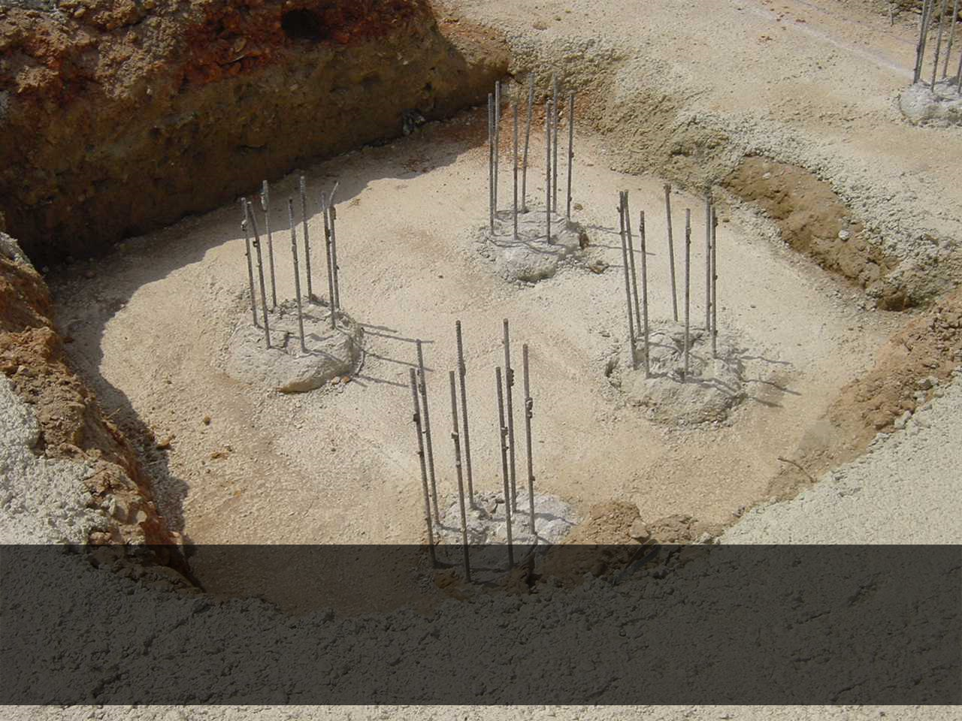
Architecture

Slide 41
Traditional Architecture
Presentation
Business Logic (BLL)
Infrastructure
Data Access (DAL)
Notes:
-DAL talks to SQL
-BLL talks to external systems
-Presentation talks to the web
-Each layer depends on bits in from the layer underneath
-So if you want to add something, first you have to add it in the DAL, then BLL
-That’s why we found business logic scattered from one end to the other

Slide 42
Onion Architecture
User Interface
G
Application Services
M
Domain Services
Database
Domain Model
Services
File
system
Tests
Infrastructure
etc
Notes:
-Domain model != view model
-The M in MVC
-Instead of depending downwards, dependencies goes inwards

Slide 43
Onion Architecture
EmployeeController
User Interface
G
Application Services
M
IEmailSender
Domain Services
Database
Domain Model
Services
Employee,
IEmployeeRepository
File
system
Tests
Infrastructure
SmtpEmailSender
etc
NHibernateEmployeeRepository

Slide 44
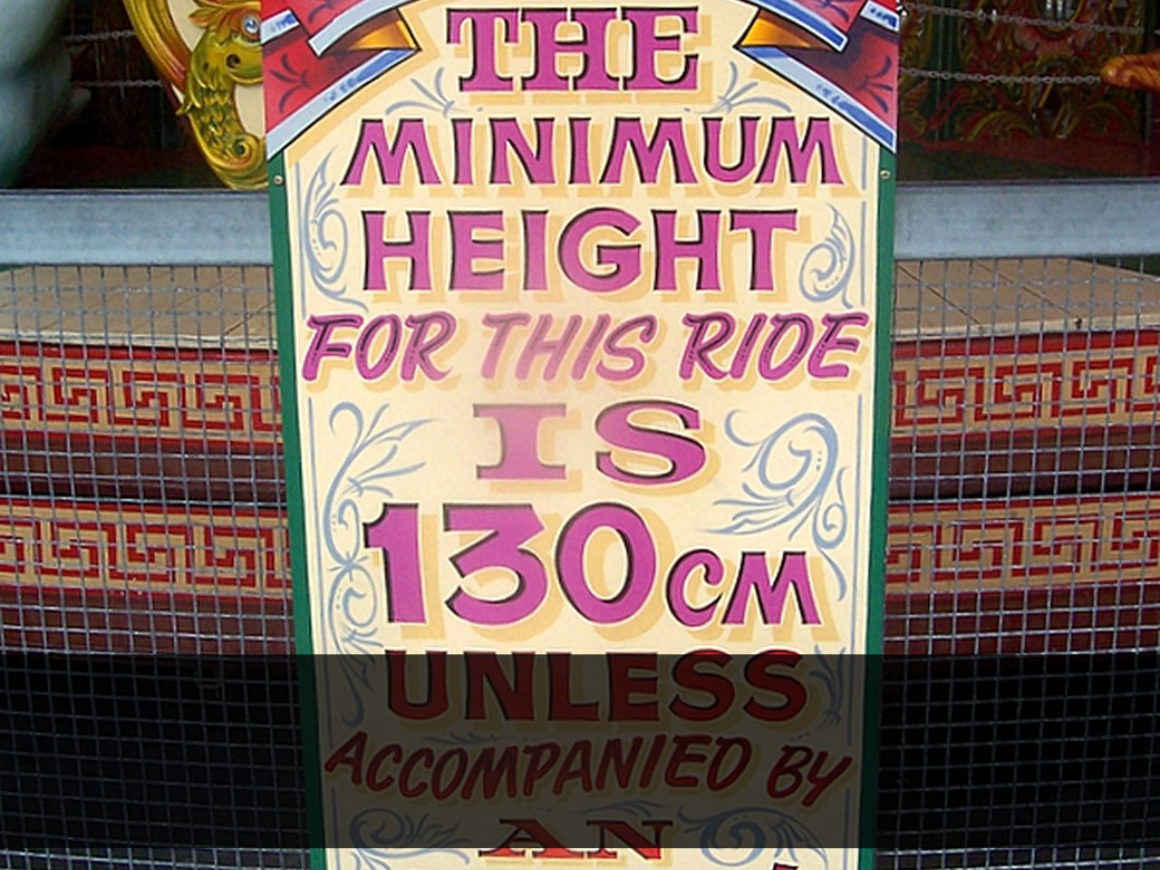
Validation

Slide 45
Validation Examples
Input validation
Is the first name filled in?
Is the e-mail address format valid?
Is the first name less than 255 characters long?
Is the chosen username available?
Is the password strong enough?
Is the requested book available, or already out on loan?
Is the customer eligible for this policy?
Business domain
Notes:
-255 = persistence validation, done by ORM

Slide 46
public class PersonRepository : IPersonRepository
{
public void Save(Person customer)
{
if (!customer.IsValid())
throw new Exception(...)
}
}
validation and persistence anti-patterns
Notes:
-Nieve example of things you dont wanna do
-Repository doing CRUD
-Validating only before it writes to the DB
-self-validating entities (doesn’t work for different contexts)
-E.g. Hasn’t chosen an insurance policy yet, but doesn’t make them an invalid cusomter

Slide 47

The golden rule for validation:
The Domain Model is always
in a valid state

Slide 48
public class NewUserFormValidator : AbstractValidator<NewUserForm>
{
IUsernameAvailabilityService usernameAvailabilityService;
public NewUserFormValidator()
{
RuleFor(f => f.Email).EmailAddress();
RuleFor(f => f.Username).NotEmpty().Length(1, 32)
.WithMessage("Username must be between 1 and 32 characters");
RuleFor(f => f.Url).Must(s => Uri.IsWellFormedUriString(s))
.Unless(f => String.IsNullOrEmpty(f.Url))
.WithMessage("This doesn't look like a valid URL");
RuleFor(f => f.Username)
.Must(s => this.usernameAvailabilityService.IsAvailable(s))
.WithMessage("Username is already taken");
}
}
separation of validation concerns with FluentValidation
Notes:
-Cos when you think about
-We don’t validate domain entities
-We validate forms and actions people try and submit via the UI
-Domain model != view model

Slide 49
Where validation fits
EmployeeController
User Interface
G
Application Services
M
IEmailSender
Domain Services
Database
Domain Model
Employee,
IEmployeeRepository
Services
NewUserForm,
NewUserFormValidator
IOverdraftLimitPolicy
File
system
Tests
Infrastructure
SmtpEmailSender
IUsernameAvailabilityService
etc
NHibernateEmployeeRepository

Slide 50
Making Roles Explicit

Slide 51

Challenges
Notes:
-Learning curve
-Requires a lot of buy in
-Fitting into the landscape
-Code
-People
-conceptual contours, generic subdomains, distributed domain driven design

Slide 52
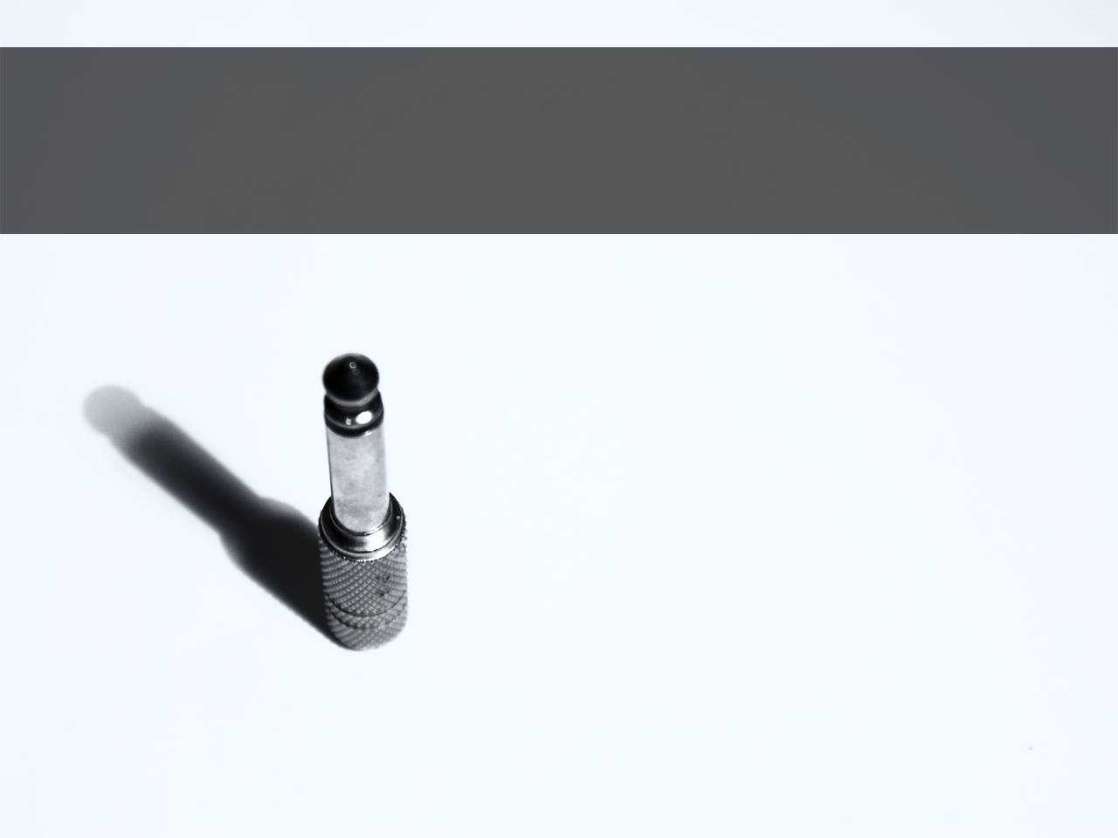
When DDD isn’t appropriate
Notes:
-DDD is for dealing with complex domains
-If you don’t have a complex domain
-If you have no behaviour or logic
-If your ’model’ maps perfectly to a relational DB schema
-Clues that you don’t need DDD
-If you don’t have access to a domain expert
-Use it as a pattern language
-Only for OO, e.g. no device drivers

Slide 53

Benefits
Notes:
-But if you do
-Model that’s much easier to understand
-Everything in one place
-Ubiquitous language
-End up with code that’s almost readable by non-technical domain experts
-OO done right
-Isolation makes it much easier to unit test
-Not dependent on technical details
-Much easier to refactor
-Not a cure for complexity
-Not a golden bullet
-Overall it’s about lifting our game
-At the end of the day we are craftsmen
-People come to us
-Expect our code to work for a long time
-DDD is about achieving that longterm maintainability

Slide 54
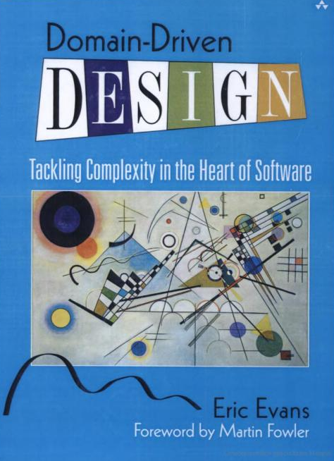
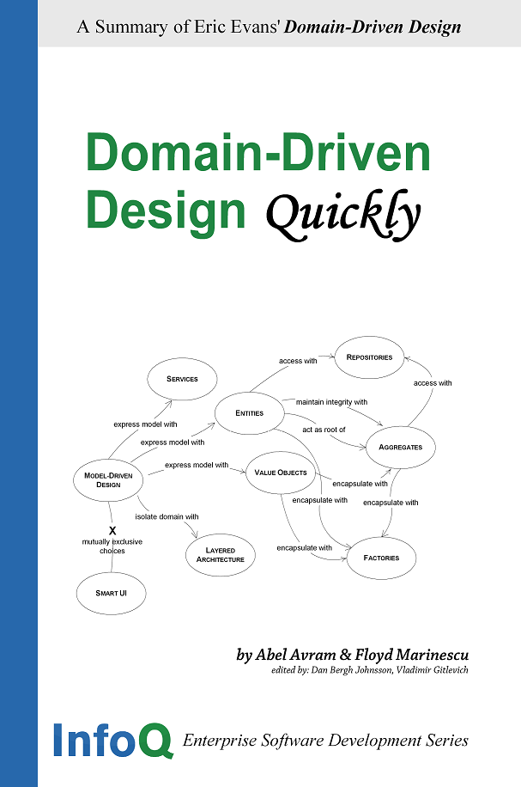
Books
Notes:
-So where to from here
-You really wanna read this book

Slide 55
Links
Domain Driven Design mailing list
http://tech.groups.yahoo.com/group/domaindrivendesign/
ALT.NET mailing list
http://tech.groups.yahoo.com/group/altdotnet/
DDD Step By Step
http://dddstepbystep.com/
Domain Driven Design Quickly (e-book)
http://www.infoq.com/minibooks/domain-driven-design-quickly

Slide 56
Any fool can write code that a computer can understand. Good programmers write code that humans can understand.
Martin Fowler
Notes:
-Just before you go

Slide 57



Thanks for listening!
http://twitter.com/dingwallr
http://richarddingwall.name
rdingwall@gmail.com

